Slide 1
Title: Verifying a programmable multiprocessor.
Abstract: Much of what NVIDIA is currently doing to verify our multiprocessor implementation would be unrecognizable to engineers from a decade ago. In the last few years, NVIDIA traded its oral tradition of tribal knowledge for formal and executable specifications of the memory model. In this talk I will very briefly summarize some of the key academic work leading to, and including, what we are doing now.
Bio: Olivier is a principal architect at NVIDIA and a member of the ISO C++ committee. His main focus is to prove and improve the soundness of the GPU’s programming model, nominally for business reasons and often by changing the architecture. He majored in mechanical engineering.

Slide 2
Memory Modeling
Community
ISO C++ Committee
NVIDIA
ogiroux@nvidia.com
GPU Architecture
Principal Engineers

Slide 3


Verifying a programmable multiprocessor.
Olivier Giroux, Stanford lunch, 04.08.2016
Hi!

Slide 4
Recipe:
Formalize memory model.
Falsify axioms, reduce to SAT, enumerate bounded executions.
Extract programs from executions, run.
Are executions observed on silicon? Those would be the bugs.
This is its own difficult problem for another day.

Slide 5
We’ll get back to this later.
Now: the roads to and from memory models.

Slide 6

Sequential Consistency, Leslie Lamport, 1979. http://www.news.cs.nyu.edu/~jinyang/fa09/papers/lamport-consistency.pdf
Operations execute in some sequential order, consistent with program order in each thread.
Like a zipper.

Slide 7


Data-race-free model, Sarita Adve, 1990. http://rsim.cs.uiuc.edu/~sadve/Publications/isca90.ps
Software shall obey synchronization model, else is undefined.
Synchronization model DRF-0:
synchronization operations are explicitly identified, and
conflicting accesses are ordered with synchronization.
Synchronization.

Slide 8

Atomicity, William Collier, 1992. Reasoning About Parallel Architectures, Prentice Hall.
Multiple-copy atomicity = operations are serializable.
(Multi ple -copy atomicity excepts reads with localized order.)
Single-copy atomicity = operations are applied indivisibly.
Indivisible.
Serializable.

Slide 9
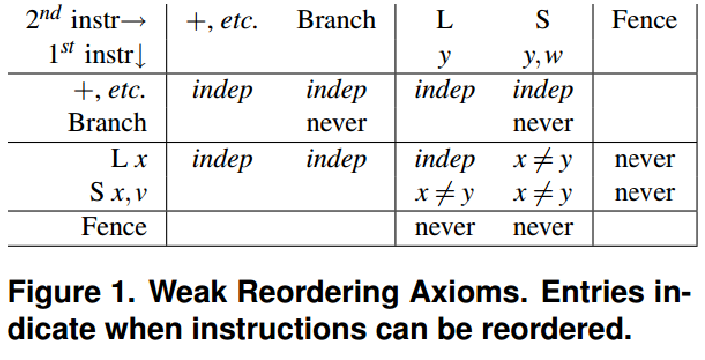
Atomicity + Reordering, Arvind, 2006. http://csg.csail.mit.edu/pubs/memos/Memo-493/memo-493.pdf
State all executions are multiple-copy atomic.
Explain relaxations as reordering by the machine.
Serializable.

Slide 10
Partial-order models, Jade Alglave, 2010. http://www0.cs.ucl.ac.uk/staff/J.Alglave/these.pdf
State all executions are single-copy atomic.
Explain invariants as constraints on an inscrutable machine.
Indivisible.
acyclic[…].

Slide 11

Now forget the zipper, there is no time axis.
Time is only increasing entropy in a bubbly foam of possible universes.
Causality only flows from observation, never affirming the consequent.
Without all-seeing Oracle, zipper analogy is vacuous.
Your timE is A LIE!

Slide 12
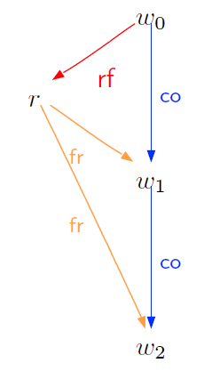
acyclic[ ok, but what goes here? ] Or: please refer to Jade’s PhD thesis.
Static relations:
po, program-order, relates operations in sequence order within each thread.
Dynamic relations:
co, coherence, relates writes in the order committed to each location.
rf, read-from, relates writes to reads satisfied by that write’s effect.
fr, from-read, relates reads to writes committed co-after satisfying effect.

Slide 13
Examples in Alloy syntax
SC :
acyclic[ po + co + rf + fr ]
TSO :
acyclic[ (po – W->R) + (*po:>F).*po + co + rf + fr ]
RMO :
dep = dependent operations
po-loc = *po & address.~address
acyclic[ dep + po-loc + (*po:>F).*po + co + rf + fr ]

Slide 14
Q: Is a pattern emerging?
Is it always in the form, let f(po):
acyclic[ f(po) + co + rf + fr ]
A: No. We’re still describing zippers.
Non-multi-copy atomic theories constrain co, rf and fr separately.

Slide 15
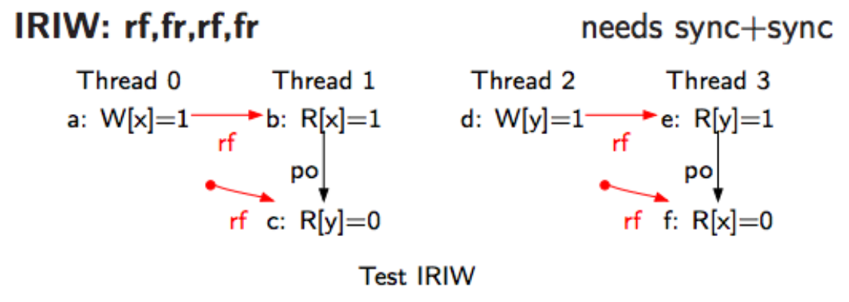
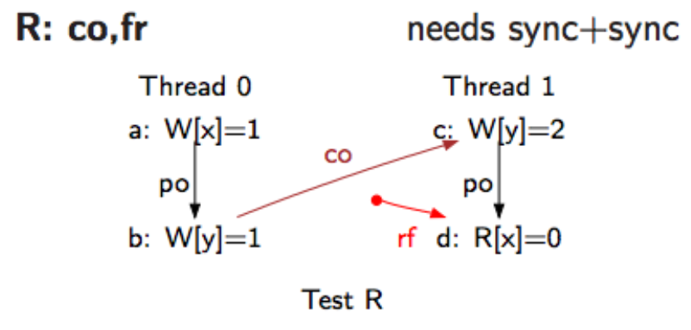
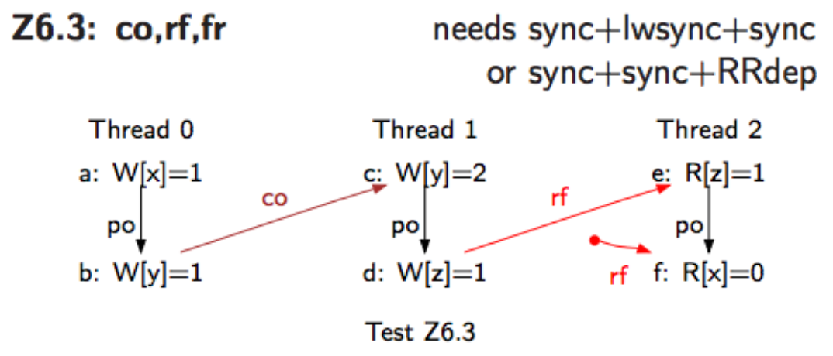
Why? Programs with co races are vacuous. https://www.cl.cam.ac.uk/~pes20/ppc-supplemental/test6.pdf
Racing threads don’t witness the outcome.
i.e.:
Races on co do not establish causality.
These litmus tests were also invented by William Collier, in 1992.
There aren’t many in this presentation but they’re super important.

Slide 16
Theories for POWER/ARM-like systems https://www.cl.cam.ac.uk/~pes20/ppc-supplemental/test7.pdf
acyclic[ po-loc + co + rf + fr ]
lfence = (*po:>LF).*po – W->R
cause = dep + lfence + rf
acyclic[ cause ]
irreflexive[ fr.^cause ]
acyclic[ co + ]
drf0 baseline axiom, “sc per location”
axiom on rf, “no thin air”
axiom on fr, “observation”
axiom on co, “propagation”
Uh oh. This part is really inelegant.

Slide 17
Unnamed idea Viktor Vafeiadis, 2015. Unpublished?
New dynamic relation:
sync, synchronizes, relates heavy fences in some unique total order.
hfence = (po:>HF).*sync.po
cause = dep + lfence + hfence + rf # redefined
irreflexive[ (co + fr ).^cause ] # redefined
acyclic[ + co ]
Haha… nope!

Slide 18
NVIDIA’s base theory is a streamlined POWER
//Streamlined Causal Consistency
pred scc {
acyclic[rf + co + fr + po_loc] // sc per location
acyclic[rfe + dep] // no thin-air values
no fr.co & rmw // rmw atomicity
irreflexive[(rf + co + fr).^cause] // causality
}
fun fence[] : MemoryEvent->MemoryEvent {
// There is no total order among FenceAlls
((^po :> FenceAll).^po) - Write->Read
+ // There is a total order among all FenceSCs
(^po :> FenceSC).*sc.^po
+ // po ending in a Release, plus C++ release sequences
(^po :> Release).*(po_loc :> Write)
+ // po starting at an Acquire
Acquire <: ^po
}
fun cause[] : MemoryEvent->MemoryEvent {
rfe + rmw + fence
}

Slide 19
NVIDIA’s complete theory
// embargo lifts when Volta GV100 ships

Slide 20
Alloy (MIT) http://alloy.mit.edu/alloy/
Fortuitous facts:
FOL
Graph theory
Palatable syntax
Scriptable
Less fortuitous facts:
SAT.
Still, totally practical for small arities.

Slide 21
Neat things you can do with Alloy : logic diff
run {
basic_model
not acyclic[ po + co + rf + fr ]
} for 6
Every solution is a non-SC execution that our system can produce.
(Will emit all solutions of arity 6 or less, exhaustively.)
In fact, you can ‘diff’ any two memory models. Or any two models, period.
e.g.: Especially useful to diff your own model across a revision.

Slide 22
What about this?
run {
not basic_model
} for 6
Every solution is a behavior that the system shall not produce…
(Wait... it’s it’s ALL the behaviors the system shall not produce!)
…but does it?

Slide 23
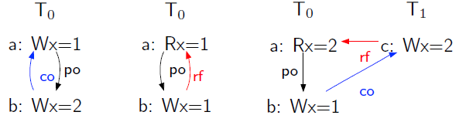
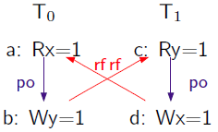
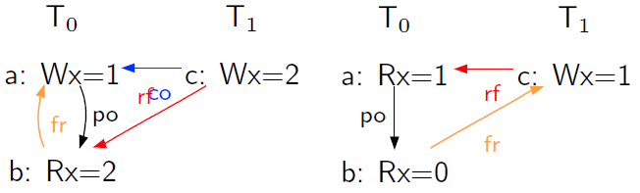
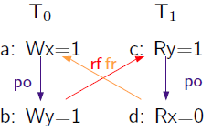
There are a ton of fun, challenging problems
Requested
Delivered
LULZ!

Slide 24
Solution domains
Limited human guidance. Primarily logic binning/siloing.
Redundancy elimination, e.g. by canonicalization.
Higher-order solutions. Co-solving an optimization theory.

Slide 25
So that all happened.
Shout out to Andy Wright!

